Slide 1
Digital Portfolio
STUDENT NAME: Mohanraj.M
REGISTER NO AND NMID: 222403557/5639883CE46922A98FD43F51E7b98BC6
DEPARTMENT: Bsc computer science
COLLEGE: Sri devi arts and science college/Madras University

Slide 2
PROJECT TITLE
MY TO DO LIST

Slide 3


AGENDA
Problem Statement
Project Overview
End Users
Tools and Technologies
Portfolio design and Layout
Features and Functionality
Results and Screenshots
Conclusion
Github Link
3/21/2024 Annual Review

Slide 4

PROBLEM STATEMENT
To do list page (index.html) with items, cart functionality, and animations. A login form page where users enter details After login, the user should be redirected to the to do list page.

Slide 5

PROJECT OVERVIEW
🎯 Goal To create a to do list website Allows customers to add items to their cart and view them dynamically. Has a login page where customers must enter their details before accessing the to do list

Slide 6

WHO ARE THE END USERS?
Customers/Shoppers: These are people who use the site to browse various items, add products to their shopping cart, and complete purchases. They can be casual browsers, bargain hunters, product-focused, researchers, or one-time shoppers, each with slightly different usage patterns. Shop Owners/Vendors: These users manage their own storefronts within the shopping mall platform. They upload products, handle orders, and interact with customers as needed.

Slide 7

TOOLS AND TECHNIQUES
Payment Gateways: Stripe, Apple Pay, Google Pay, and EFT gateways enable secure and seamless transactions for customers. Inventory Management: Integration of inventory tools ensures product availability is always updated and synced across website and physical stores. SEO Tools: Platforms like Moz help optimize the website for better search engine rankings and organic traffic, while built-in SEO tools are provided in most modern e-commerce builders

Slide 8
POTFOLIO DESIGN AND LAYOUT
Prominent Imagery: Use high-quality images or carousels as a focal point on the homepage and key sections to display top sales, product launches, or mall events. Bold Colors and Fonts: Build layouts around theme colors and bold headings to make key areas—such as sales, promotions, or new arrivals—stand out. Intuitive Navigation: Implement clear menus, easy-to-find search bars, and category filters for simple browsing of stores, products, and services.
8

Slide 9
FEATURES AND FUNCTIONALITY
Product Grid: Products are displayed in a responsive grid, each with image, name, and price. Add to Cart: Each product has an button to add items to a cart using JavaScript. Repeated clicks add to the quantity. Cart Panel: A fixed-position cart panel shows current selected items and their quantities when the cart icon is toggled. The cart animates in and out for smooth user experience. Animated UI: Items float gently via CSS animation, and the cart panel slides in using keyframe animations

Slide 10
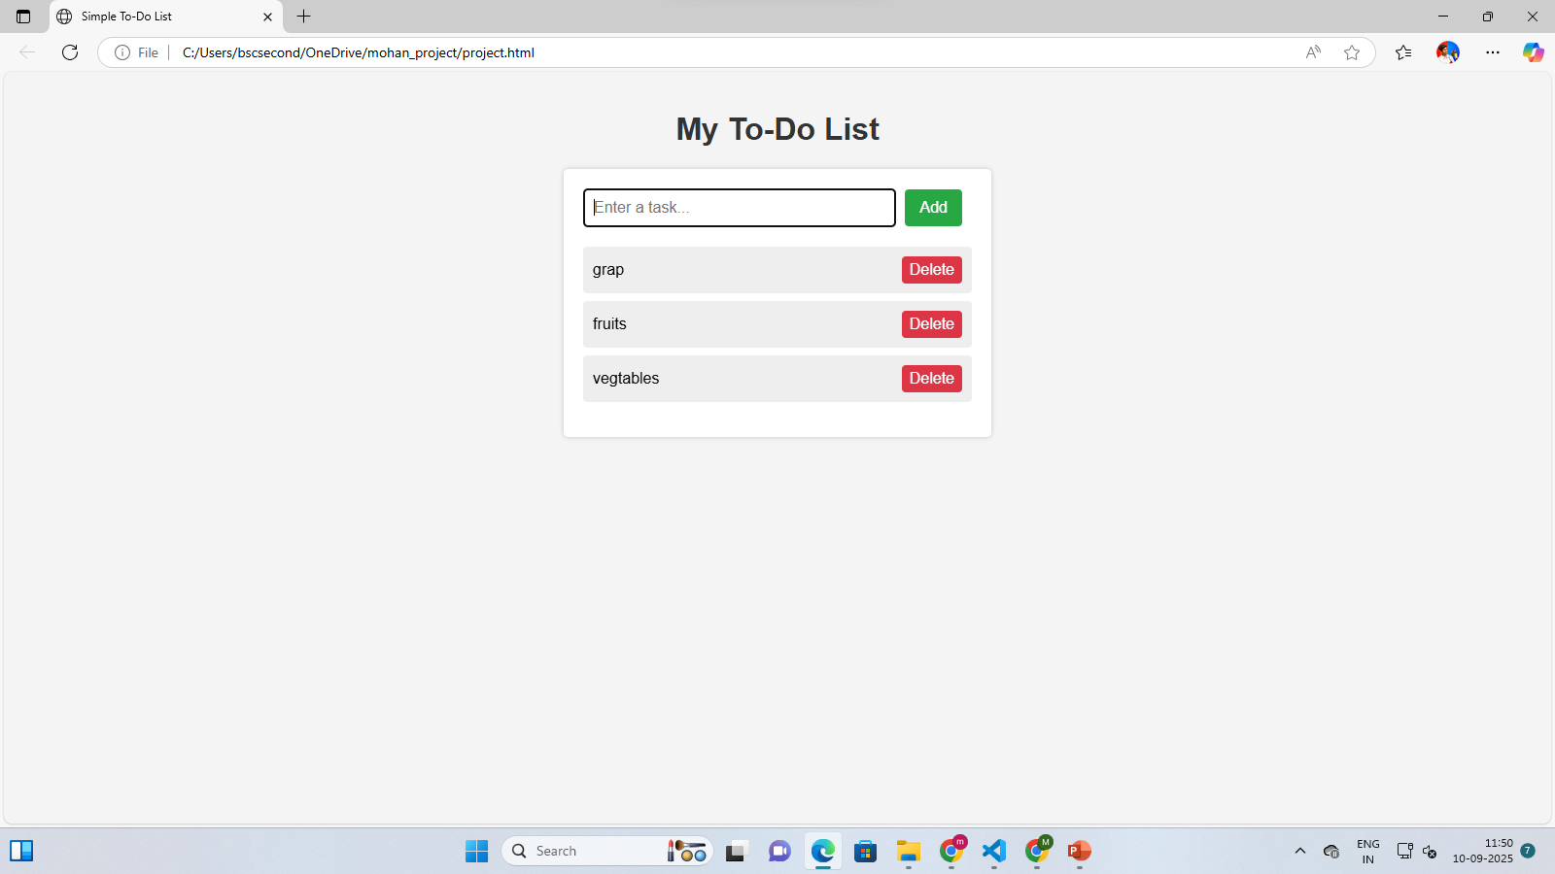

RESULTS AND SCREENSHOTS
The provided code bundle includes two separate HTML pages styled and scripted for a front-end e-commerce platform “Mohan Shopping Mall
3/21/2024 Annual Review
10

Slide 11
CONCLUSION
The implementation exemplifies a front-end-focused shopping mall site, encompassing interactive product listing, animated visuals, and a styled login form—all powered by HTML, CSS, and JavaScript. For further enhancement, consider adding backend integration for real authentication and order storage, improved item management, and checkout/payment simulation for a full e-commerce experience.
11

Slide 12
GITHUB LINK

